Slide 1

Predicting White Wine Quality Ratings
By Akinde KADJO
Image from adrianysus.com

Slide 2
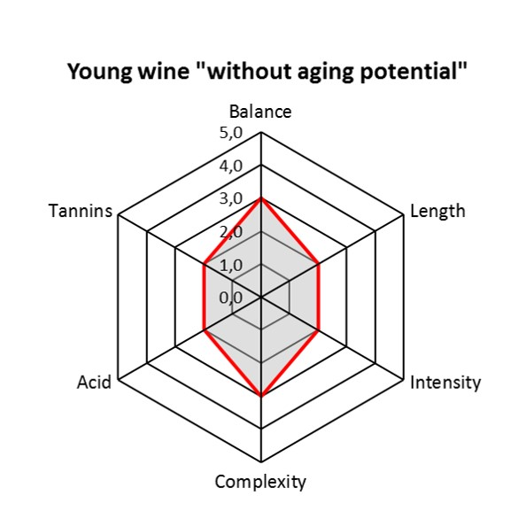
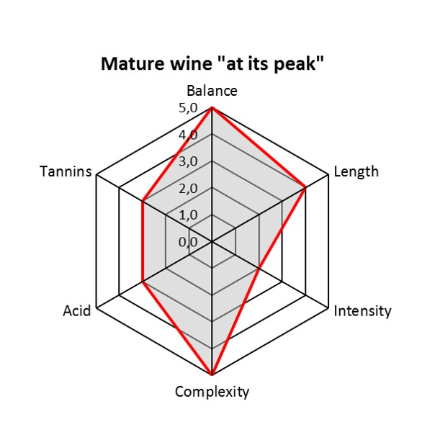
Introduction
The main indices of wine quality assessment are:
Balance (no individual parts should be overwhelming)
Length (the persistence of the taste)
Intensity (indicative of the concentration)
Complexity (reflects the aromas and flavors)
Acids
Tannins (bitter and astringent taste)
Poor Rating
Good Rating
Source info: bkwine.com

Slide 3

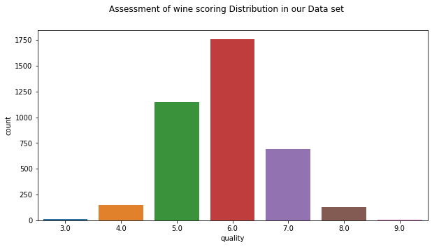



Goals & Data Overview
For this project, the goal is to model wine quality based on physicochemical tests available from a set of white vinho verde wine samples, from the north of Portugal. Data Source
Our data is overwhelmingly composed of wine quality rating #5, #6, and #7 with very few #3, #4, #8, and #9.

Slide 4
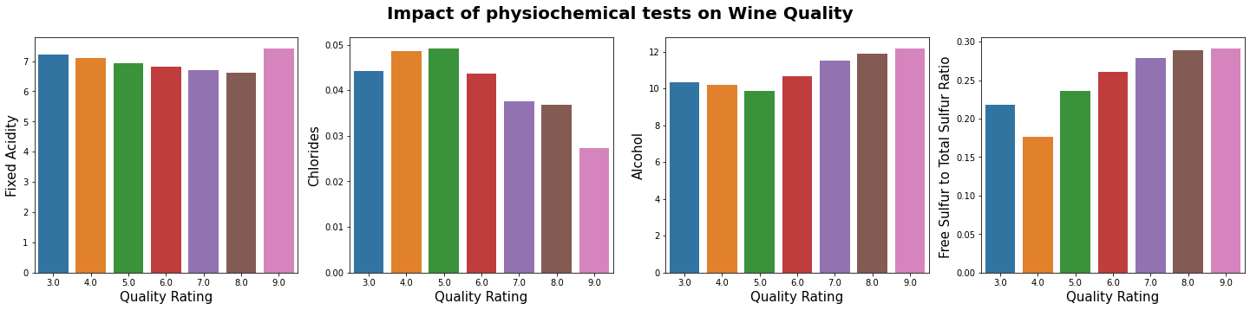
Chemical Component Analysis: Fixed Acidity
Fixed Acidity decreases as the quality rating increases except for #9

Slide 5
Chemical Component Analysis: Chlorides
Chlorides decreases as the quality rating increases except for #3 & #4

Slide 6
Chemical Component Analysis: Alcohol
Alcohol increases with the quality rating except for #3 & #4

Slide 7
Chemical Component Analysis: Sulfur Ratio
Sulfur ratio increases with the quality rating except for the change from #3 to #4

Slide 8
Machine Learning Predictions
Two approaches used: Regression & Classification methods
The best method was: Random Forest Regressor without PCA
 | Test data | Training data
RMSE | 0.6923 | 0.2668
R² | 0.3462 | 0.9110
Successful wine rating prediction was achieved within 0.7 rating unit.

Slide 9
Recommendations
Reduce fixed acidity as much as possible
As wine grapes ripen, the acidity tapers down
> Allow the wine grapes to ripen more
Seek lower Chloride levels
Soil Chemical properties affect vine nutrition
> Pick less salty soils
Increase alcohol levels
During the fermentation process the sugar is converted into alcohol
> Insure proper grape ripeness
Increase Sulfur content
Sulfur is generated during fermentation
> Better control of the fermentation Process
Sources: winefolly.com,
scielo.br , ayzanyc.com , extension.psu.edu

